Slide 1

Retail Banking Transaction Analysis
MySQL Business Analytics Project
Presented By :
Subhash Thalatam

Slide 2
About Me
I’m Thalatam Subhash, an aspiring Data Analyst with an interest in Python, SQL, Statistics, Power BI.
I built a Retail Banking Transaction Analysis project using MySQL to analyse Banking Data and generate
Meaningful insights.
Work Experience : Fresher
LinkedIn: https://www.linkedin.com/in/subhash-thalatam-78b25025a/
GitHub: https://github.com/Subhashthalatam

Slide 3
Agenda
Project Overview
Project Objective
Dataset & Database Overview
ER Diagram & Database Structure
SQL Analysis & Business Questions
Key Insights & Findings
Challenges Faced in the Project
Conclusion & Recommendation

Slide 4
Project Overview
The project contains data about customers, accounts, branches, loans, loan payments, cards, and transactions.
We analyzed customer profiles, demographics, income, credit scores, and customer segments.
We studied account usage, account balances, account types, and branch activity.
We analyzed transaction patterns, transaction types, channels, amounts, and activity over time.
We evaluated loan performance, repayment behaviour, card usage, and overall banking product engagement.

Slide 5
Project Objective
The bank manages multiple customers, accounts, branches, loans, cards, and transactions.
Management wants to understand customer behaviour and overall banking product usage.
They need to know how accounts and transactions are performing across different branches and account types.
The bank wants to identify loan performance, repayment behaviour, and customer payment patterns.
Management also wants to understand card usage and customer engagement across different banking products.

Slide 6
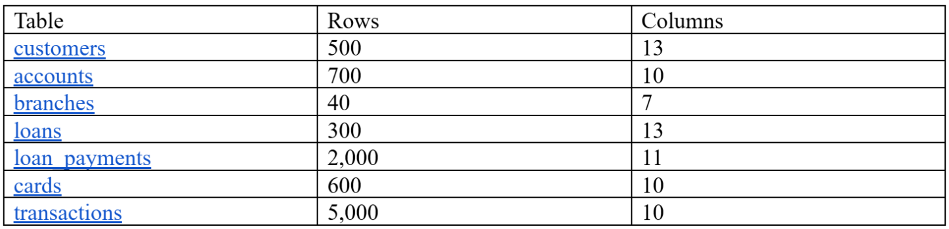
Dataset Overview

Slide 7
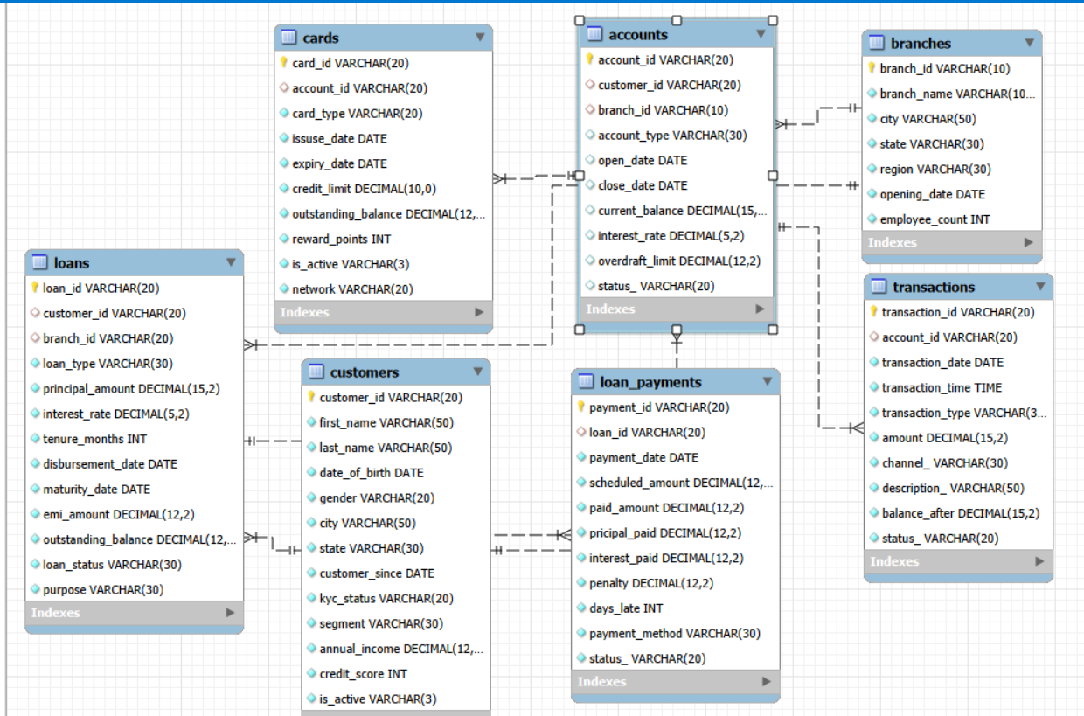
ER Diagram & Database Structure

Slide 8
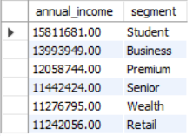
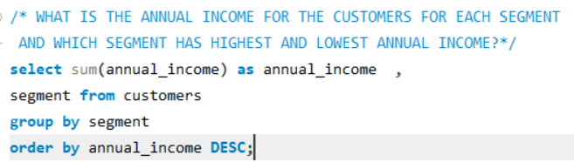
SQL Analysis & Business Questions
1.WHAT IS THE ANNUAL INCOME FOR THE CUSTOMERS FOR EACH SEGMENT AND WHICH SEGMENT HAS HIGHEST AND LOWEST ANNUAL INCOME?
Key Insights:
SO BY ANALYZING THIS RECORDS the student segment has the highest annual income and retail segment has the lowest annual income

Slide 9
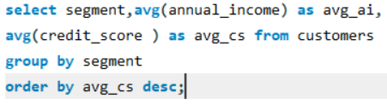
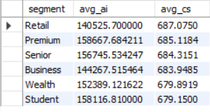
What are the average income and credit score levels across customer segments ?
Key Insights:
the Average credit score for the all the segments lies between 683-688.
The avg Highest credit Score is 687 which is maintained by Retail segment.
Here we Observe even though student has highest annual income they maintain least avg credit score

Slide 10
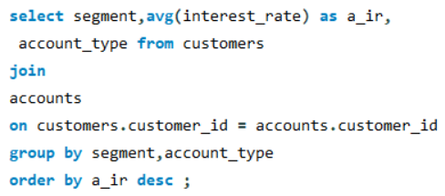
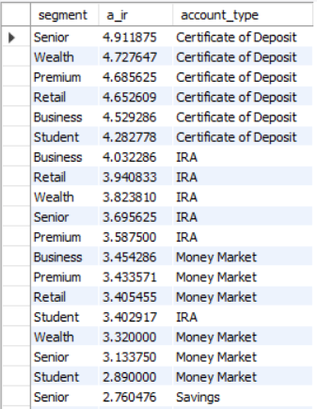
How do average interest rates for each account type vary across different customer segments?
Key Insights:
Here the senior segment who has certificate of deposit account type has the highest avg
interest rate and same senior segment has the least avg interest rate for Checking account type

Slide 11
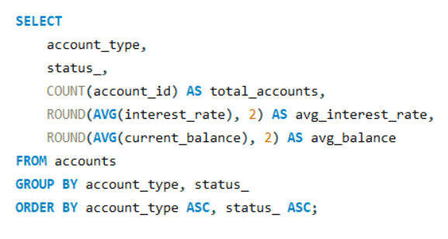
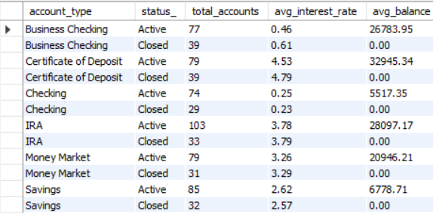
What are the major difference between active and inactive accounts?
Key Insights:
Generally, the accounts which are close they have very low avg interest rates.
Checking account type has the very least interest rate for both active and iactive accounts .

Slide 12
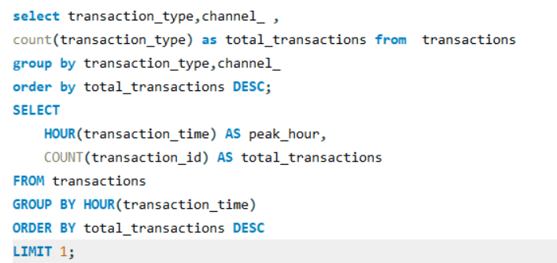

How many types of transactions available and what are the different channels??
Key Insights:
There are 6 types of transactions available,
The Most used transaction Channel is ATM.
And the Peak Hour for the Transaction is 11A.M.

Slide 13
Key Insights & Findings
Customer profiles vary across different segments, helping the bank understand differences in demographics, income, credit scores, and customer activity.
Account usage differs across account types and branches, allowing management to identify differences in account balances, activity, and interest rates.
Transaction patterns vary by transaction type and channel, helping the bank understand how customers use their accounts and how money moves through the banking system.
Loan performance and repayment behavior differ across loan types and branches, helping identify repayment delays, late payments, and outstanding loan balances.
Card usage and banking product engagement vary among customers, helping the bank understand customers using multiple products such as accounts, cards, and loans.

Slide 14
Challenges Faced in the Project
Managing multiple related tables such as Customers, Accounts, Branches, Loans, Loan Payments, Cards, and Transactions.
Creating accurate JOINs between customers, accounts, branches, loans, cards, and transactions for analysis.
Handling date-based calculations, such as transaction activity over time, loan repayment dates, and card expiry dates.
Analyzing loan repayments, delays, penalties, and outstanding balances using SQL conditions and calculations.
Combining different performance measures such as customer activity, account usage, transaction patterns, loan performance, and card usage to generate meaningful business insights.

Slide 15
Conclusion & Recommendation
Conclusion
The project helped analyze customer behavior, transaction channels, peak activity hours, loan repayment risks, and card usage using SQL queries.
The analysis highlights key trends in account activity, loan delays, and card dormancy, helping bank management make data-driven operational and financial decisions.
Recommendations
Re-activate Inactive Cards: Launch targeted promotions and reward programs to engage customers and reduce the high rate of inactive cards.
Optimize Peak-Hour Operations: Ensure strong system bandwidth and ATM maintenance during peak hours (around 11:00 AM) to prevent service disruptions.
Reduce Loan Delinquency: Set up automated payment reminders and flexible repayment options for high-risk customer segments to minimize loan delays.

Slide 16


